Slide 1
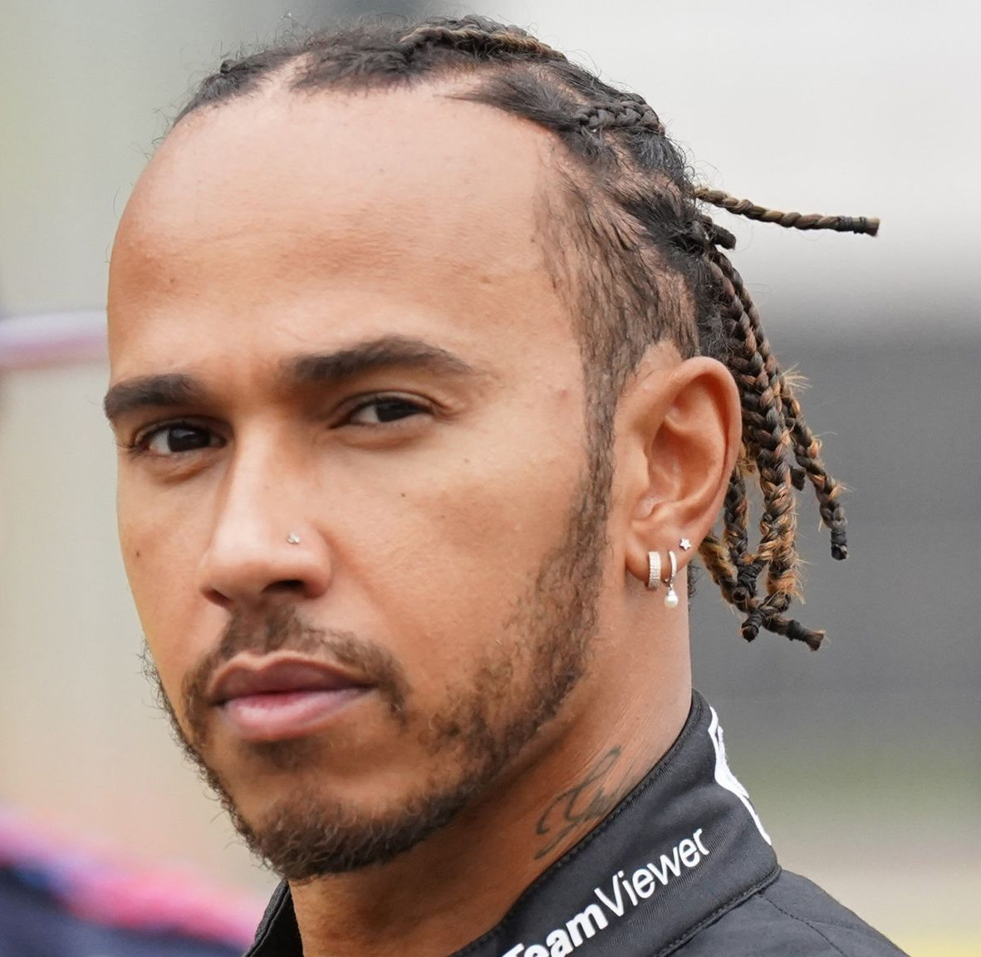


ELITE MATCHMAKER
FIND YOUR PERFECT MATCH!

